Slide 1
SHELTERBOX AND ROTARY: A PARTNERSHIP OF PURPOSE
PROVIDING SHELTER, RESTORING HOPE – MDP ALLIANCE JULY 2025
Notes:
Imagine losing everything in an instant—a flood, earthquake, or war forcing you from your home. ShelterBox steps in at that critical moment, delivering lifesaving supplies like tents, tools, and solar lights to help people rebuild their lives. That is the reality of the people we serve; people displaced by disaster! Good afternoon it is wonderful to be with you today. My name is Renee Brouse, Rotary Relation Specialist for ShelterBox USA. As a fellow Rotarian and PDG, it is fascinating to experience this end of the planning process. As I share a bit about ShelterBox let’s start with a quick video.

Slide 2
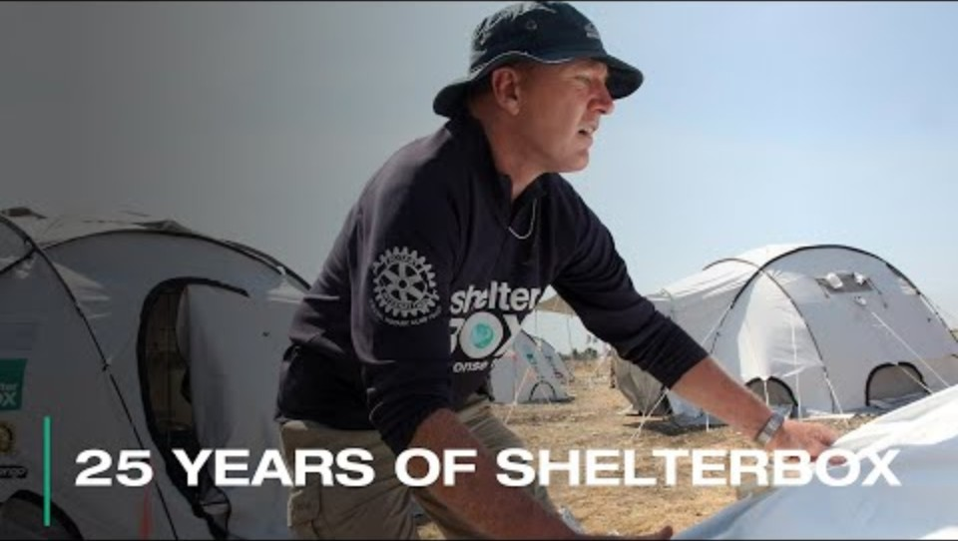
25 Years of ShelterBox | ShelterBox and Rotary Clubs and Districts
Notes:
This video captures the 25 years of ShelterBox and the critical role that Rotary has played. What I would like to do now is share what I call the why behind the what...

Slide 3
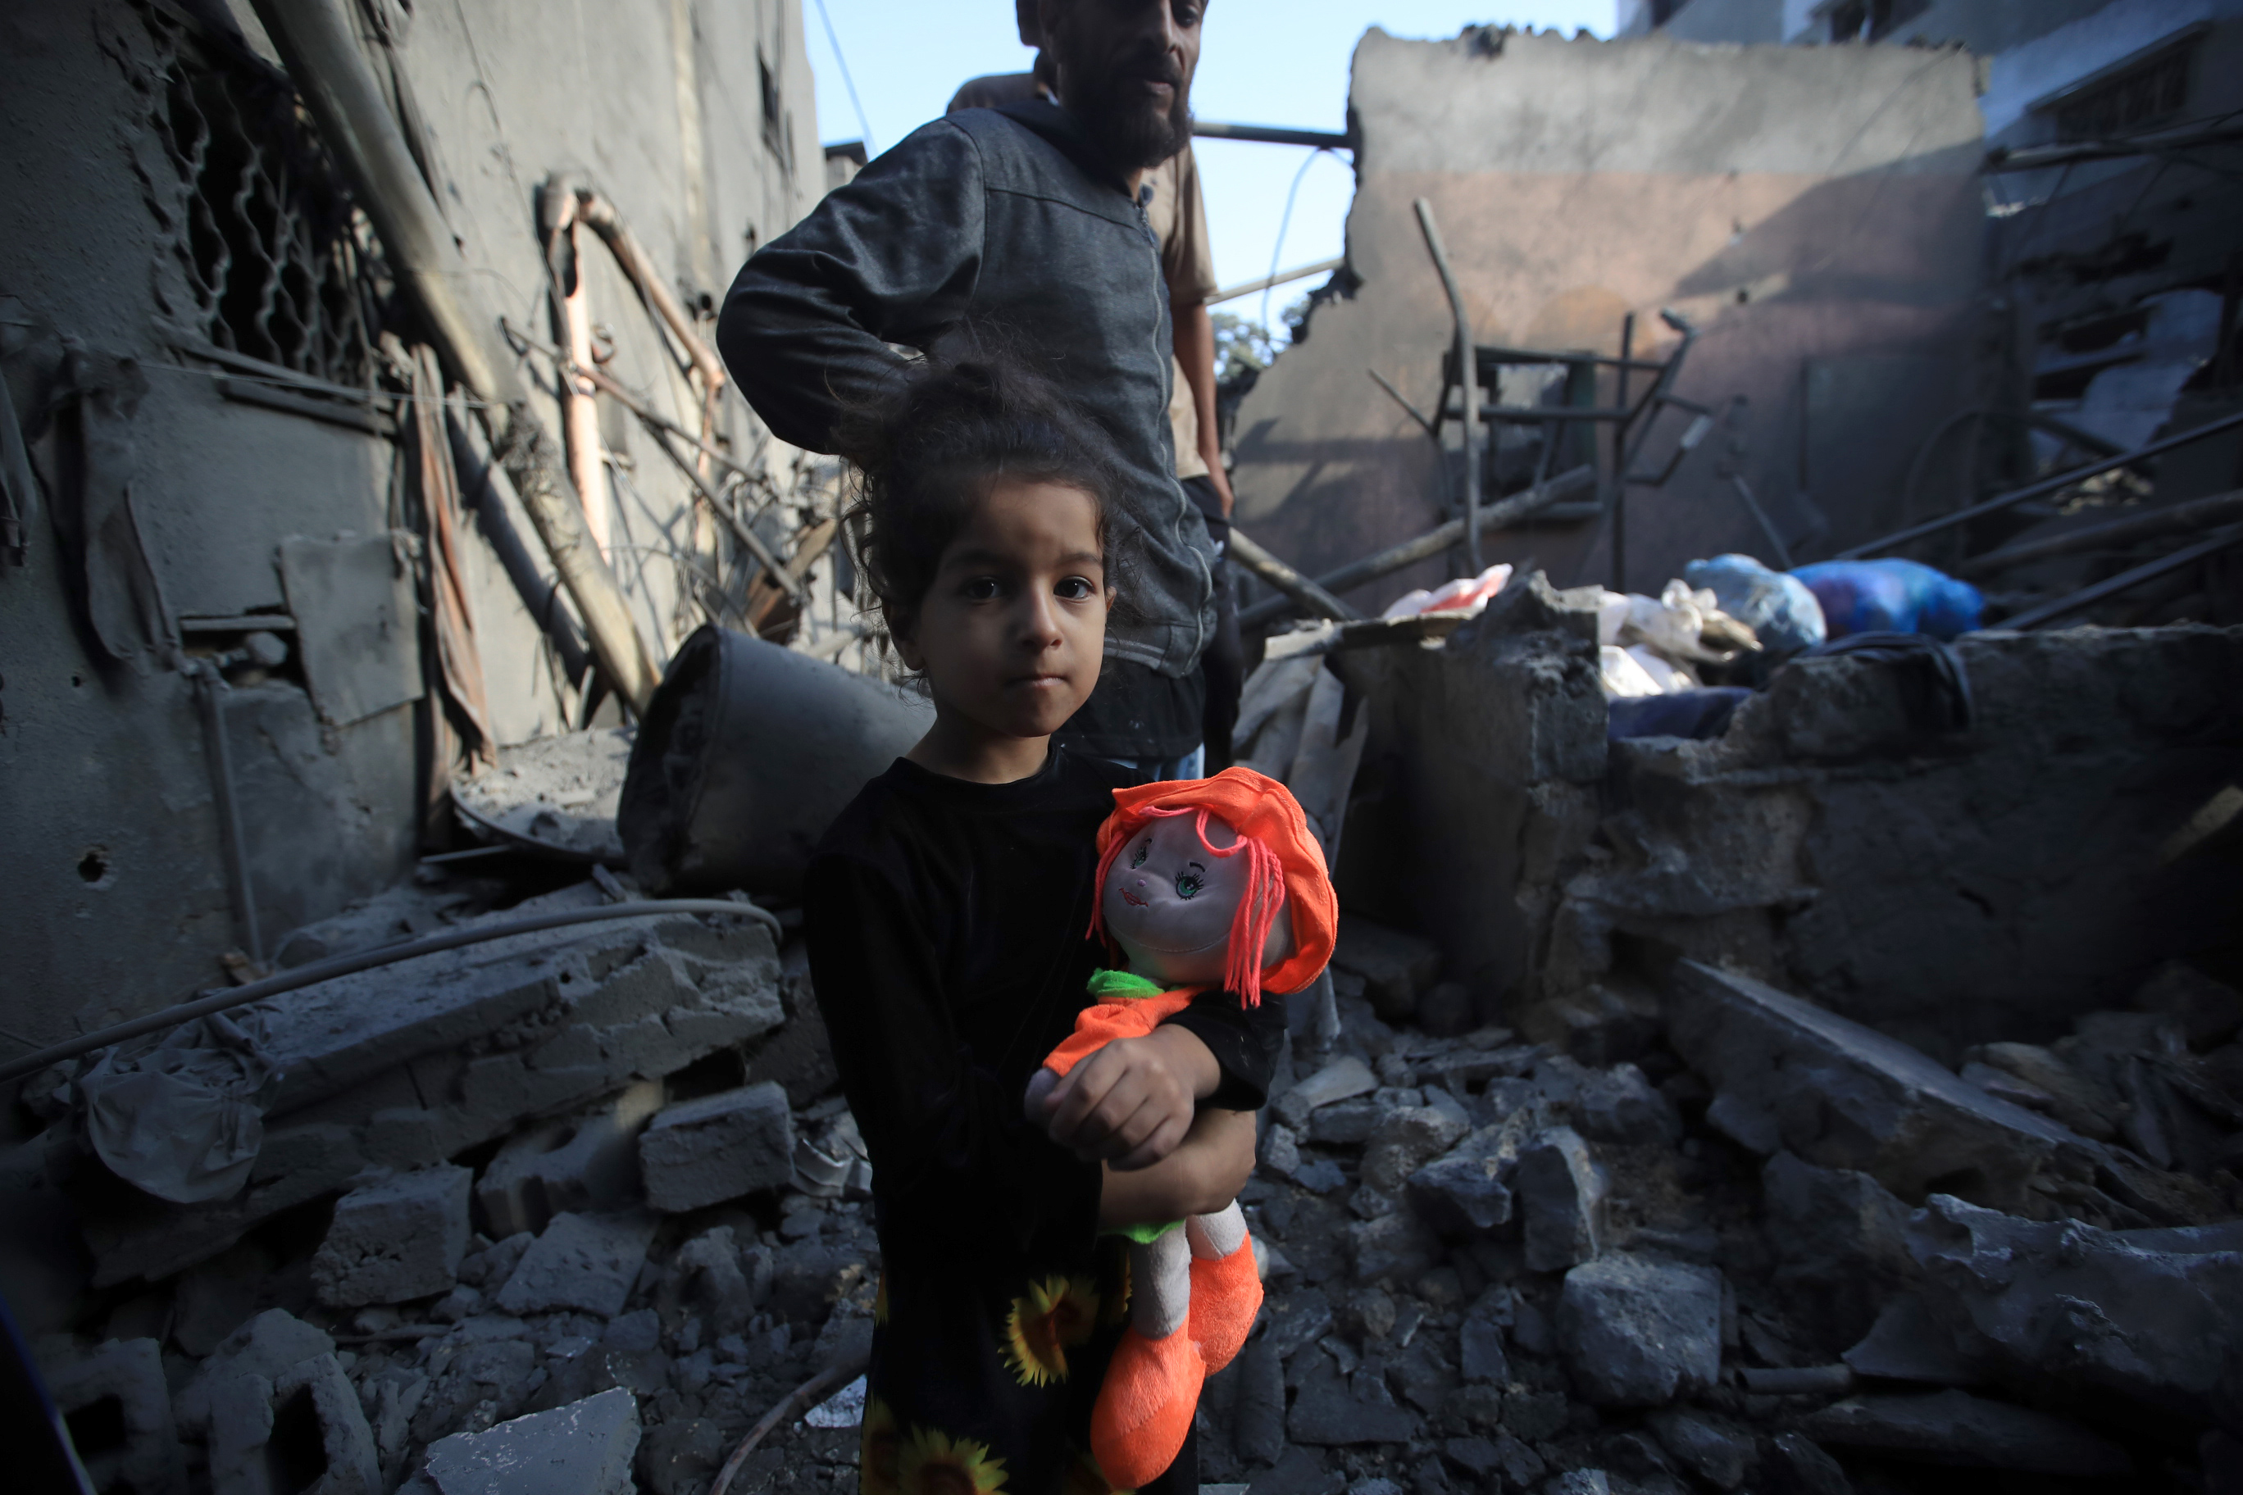
What is ShelterBox?
Global humanitarian organization
Provide shelter and shelter necessities after a disaster strikes
International Affiliates
Started by a Rotary Club
3 million people served across 100+ countries
Rotary International Project Partner
SHELTERBOX IS A REGISTERED CHARITY INDEPENDENT OF ROTARY INTERNATIONAL AND THE ROTARY FOUNDATION.
Notes:
Gaza
ShelterBox USA is a 501 c 3 nonprofit humanitarian global organization one of the affiliates under the umbrella of ShelterBox Trust headquartered in the UK. Our mission is to provide humanitarian aid in the form of shelter, warmth and dignity to people displaced by natural disasters and other disasters worldwide. We do that by providing emergency shelter, tools and household supplies to displaced families after disasters, working with partners to reach remote communities and ensure no one is left without shelter after disaster. ShelterBox got its start in 2000 by a small Rotary Club in Cornwall UK as a millennial project; their goal was to provide 8-10 boxes with disaster relief items annually. One Club’s vision became a one of a kind global humanitarian organization serving millions.

Slide 4
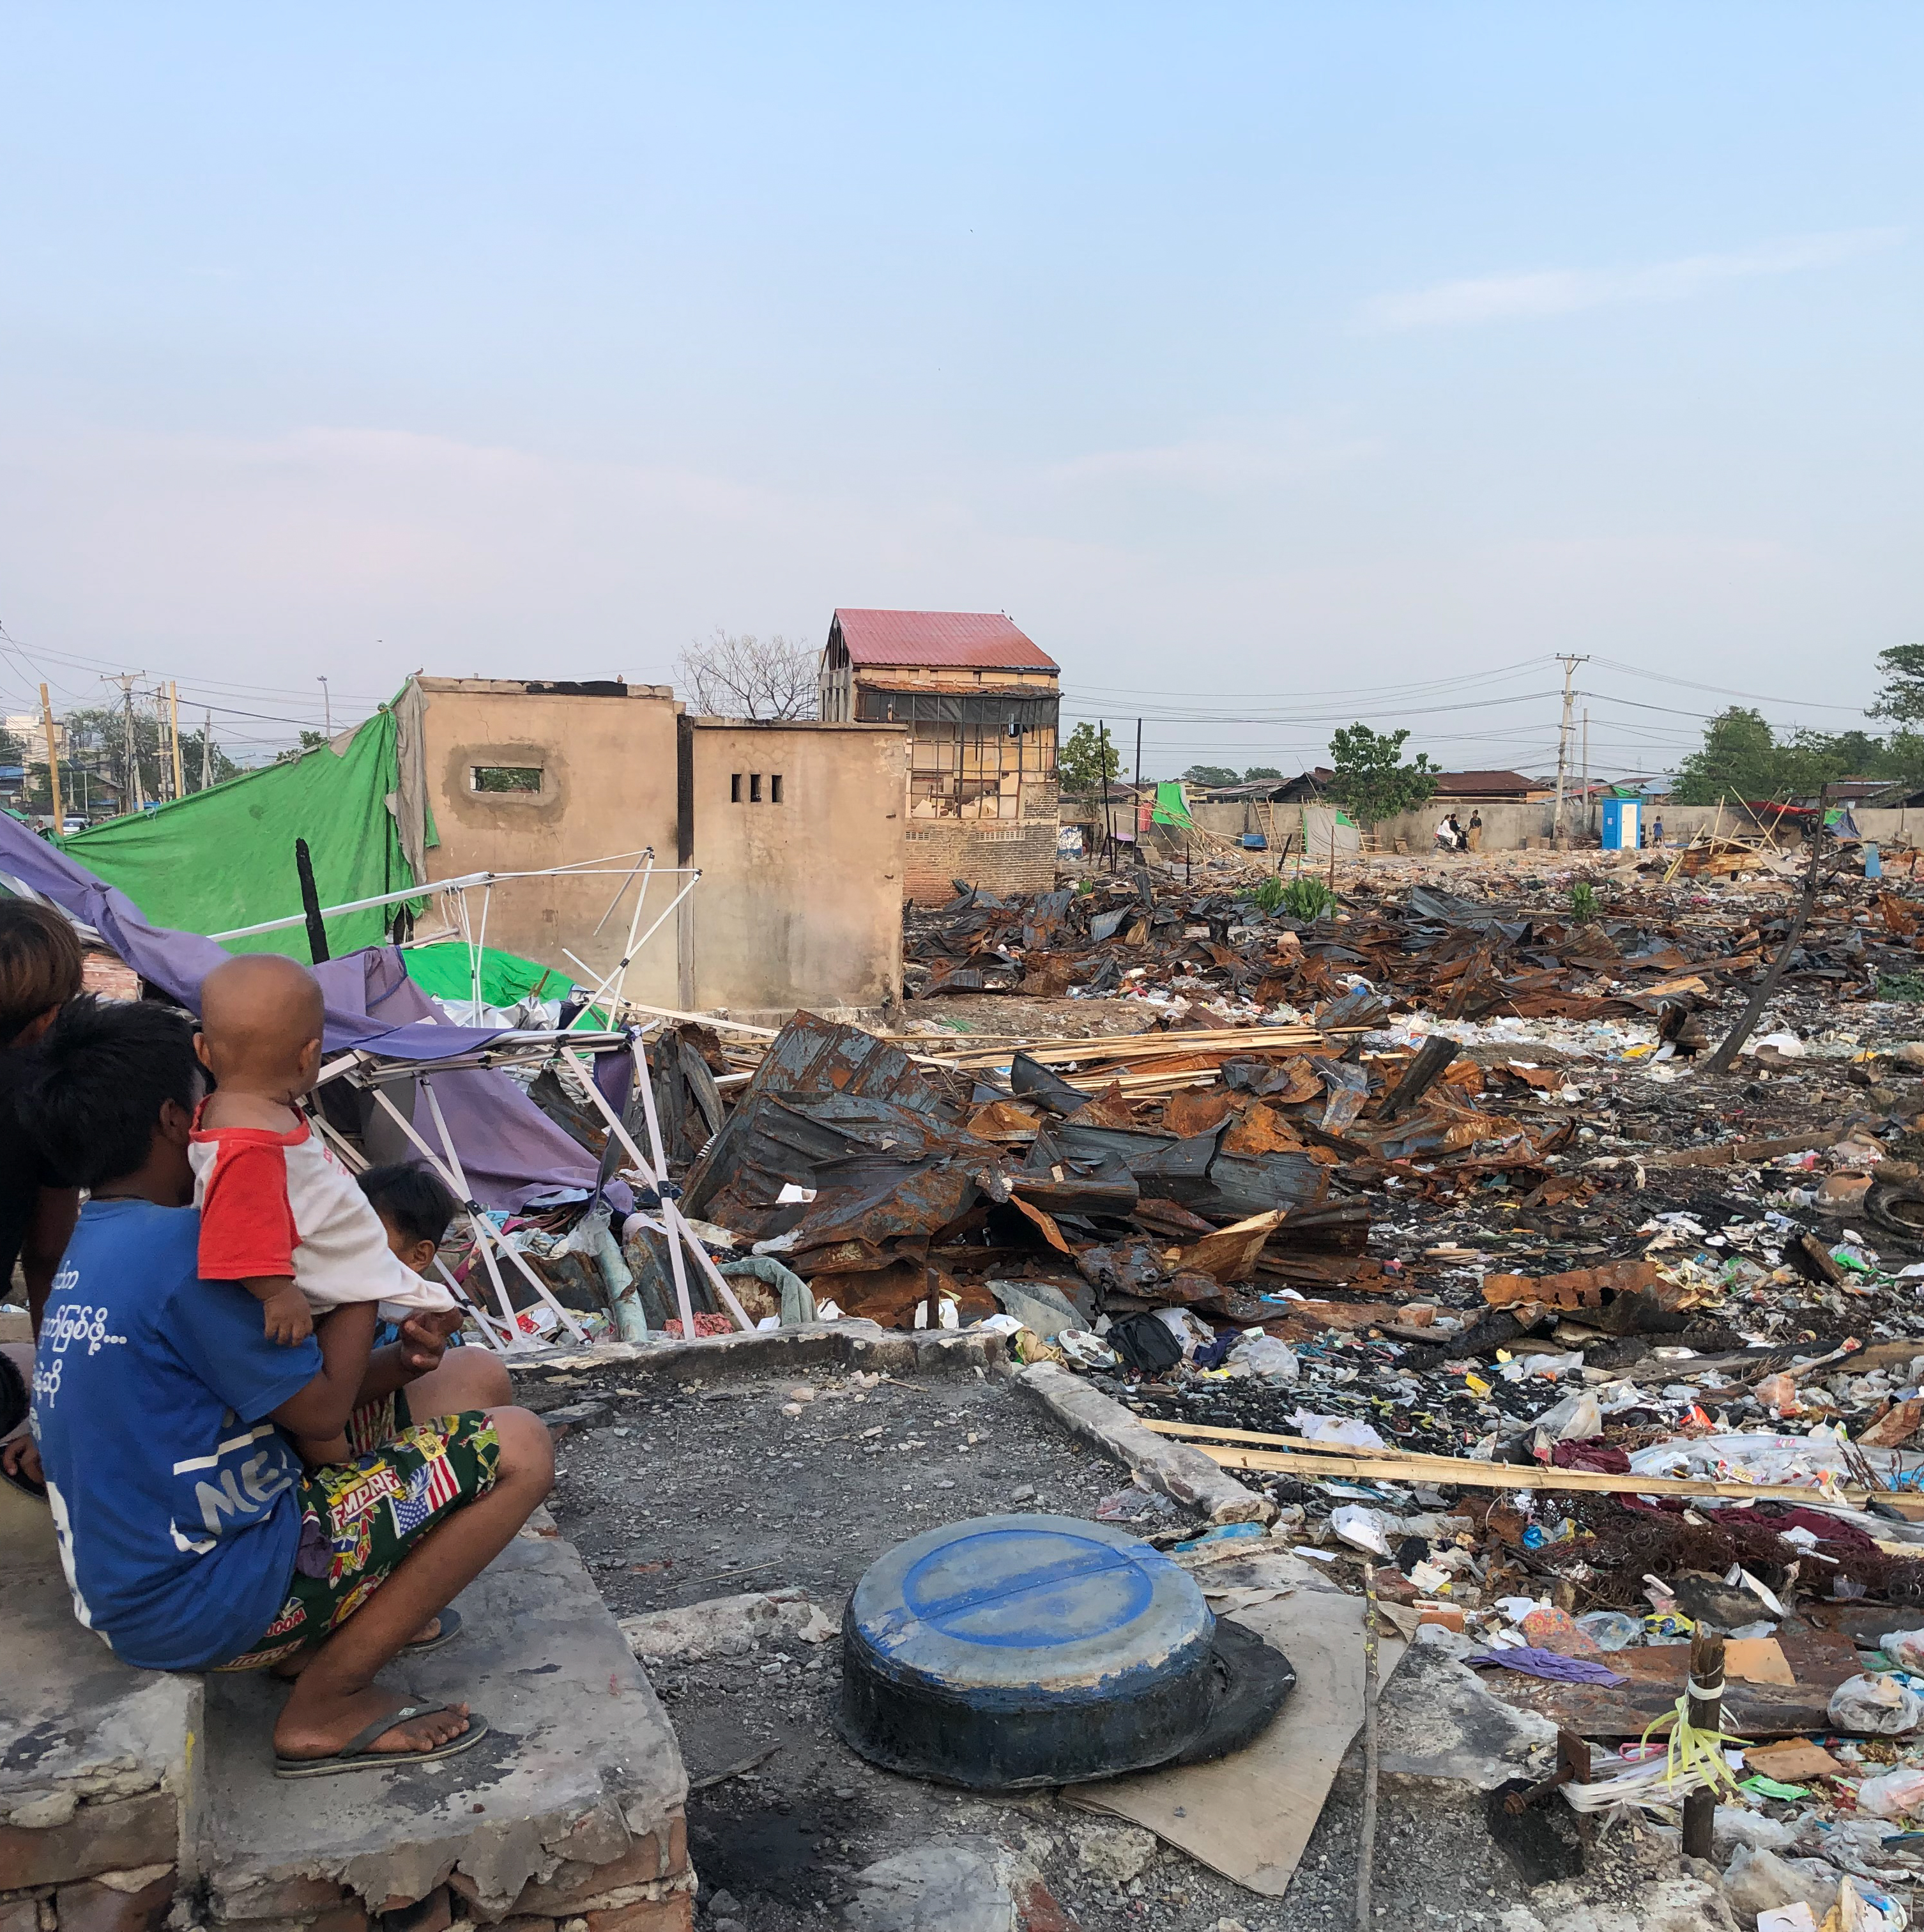
Rotary’s Role With ShelterBox
Recognized as a Project Partner in disaster relief since 2012
Rotary clubs and members are involved with ShelterBox on many levels
Service creating lasting change
Logistical support during deployments
Local connections and cultural insight
Long-term recovery efforts
SHELTERBOX IS A REGISTERED CHARITY INDEPENDENT OF ROTARY INTERNATIONAL AND THE ROTARY FOUNDATION.
Notes:
We are not supported by TRF; we are not a corporate effort of Rotary like Polio Plus; we are not a competition fo Rotary Club projects, foundations, TRF, polio or other Rotary efforts – we are a club project that has grown from a small club vision to a leader in providing shelter post disaster; a project partner for Rotary. As a project partner, the agreement enables both Rotary and ShelterBox to collaborate more closely to bring relief and temporary shelter to survivors of Disasters worldwide. The partnership builds on both or our strengths in responding to disasters all over the world. Rotarian ambassadors and club champins help create awareness of our work; Rotary clubs provide invaluable logistical support to our field operations. Rotarians are often the first point of contact for the SRT members when they arrive in country. Rotarians provide everything from translators, local knowledge, to a bed to sleep in, warehouses etc. In every aspect of the Response System, Rotary has played a CRITICAL role along the pathway

Slide 5
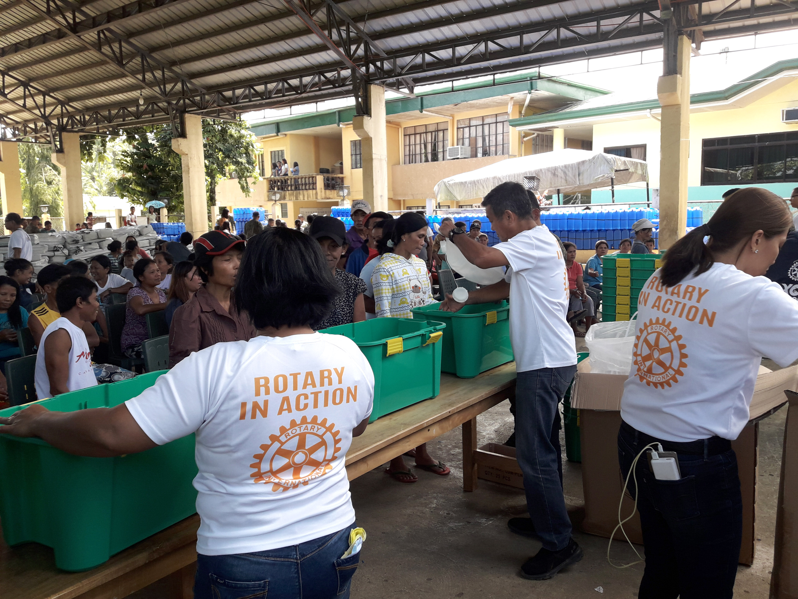
Why This Partnership Matters
SHELTERBOX HAS SUPPORTED MORE THAN
2.5 MILLION PEOPLE
around the world across almost 100 countries. People who have had to flee their homes, or had them damaged, because of disaster, conflict or the climate crisis.
Combines Rotary’s global network with ShelterBox’s technical expertise
Enables rapid, effective response in hard-to-reach areas
Builds trust with local communities through Rotary’s presence
Amplifies impact-more families reached, more lives rebuilt
SHELTERBOX IS A REGISTERED CHARITY INDEPENDENT OF ROTARY INTERNATIONAL AND THE ROTARY FOUNDATION.
Notes:
When ShelterBox and Rotary work together after disaster, the combination of ShelterBox’s technical expertise and Rotary’s connections and practical assistance mean that we can get our support to those who need it most. Rotary members might have a role to play in any one of the various stages of a response. This vital support means that we can reach more communities when disaster strikes. When ShelterBox responds in an area with an active Rotary presence, we will make every effort to inform the District Governor of the team’s presence and, where possible, will try to connect with at least one Rotary club in the affected area.
Teams will always try to provide progress reports and information on the wider response that may be of interest to Rotary. In circumstances where Rotary members cannot be involved, ShelterBox will ensure that they receive sufficient information to enable them to coordinate with the wider relief effort should they wish to.
Networking and introductions
Rotary members’ first-hand knowledge and links into communities can be a great asset, whether providing information on local culture and customs, importation procedures, security considerations or facilitating high-level introductions to support access and permissions.
Practical support
Professional services and support in areas such as the importation process, transportation or temporary storage of aid items, translation or team transport may be appropriate.
Active participation
In some situations, there may be an opportunity for Rotary members to participate actively in a ShelterBox response. If appropriate, this might involve working in various roles such as acting as a tax-free consignee for the importation of aid, collecting information for a rapid needs assessment, participating in aid distributions, or assisting with post-distribution monitoring.
These opportunities will not always be available and are dependent on both the situation and the agreement of the ShelterBox Response Team.
Participation will often require a substantial commitment in terms of time and energy and may require some training prior to engagement. Sanj, our ShelterBox CEO, will say that we cannot do the work we do without Rotary

Slide 6
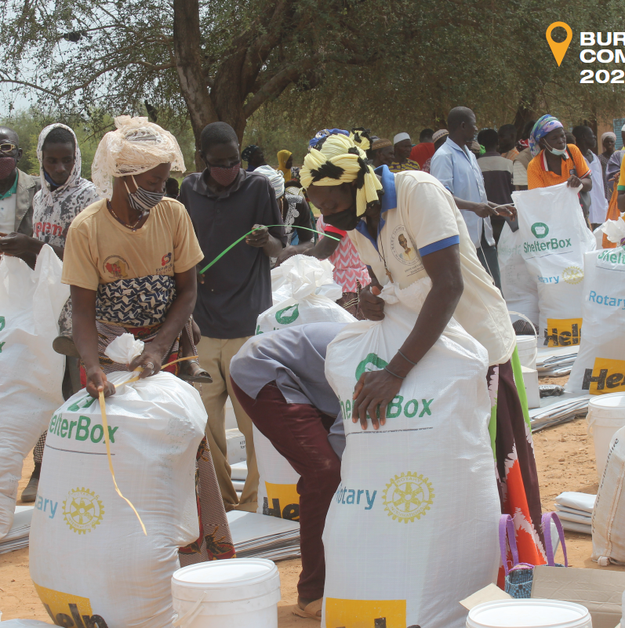
Real World Impact
Working to make a difference worldwide.
Nepal Earthquake (2015)
Morocco Earthquake (2023)
Philippines Typoon (2022)
Myanmar (2025)
North Carolina Hurricane (2024)
LA wildfires (2025)
SHELTERBOX IS A REGISTERED CHARITY INDEPENDENT OF ROTARY INTERNATIONAL AND THE ROTARY FOUNDATION.
Notes:
As mentioned above – Rotary has been involved in every aspect of the Response Cycle. For Instance:
Stronger Together
Nepal:In April of 2015, the first of several massive earthquakes shook Nepal to its very core.
The first tremor measured a shocking 7.8 in magnitude. It was felt as far away as Delhi and whole villages across Nepal were flattened.
However, thanks to our partnership with Rotary, we received reports from local Rotarians and Rotaractors on the ground.
These first-hand accounts enabled us to build a picture of the devastation and to put a plan into action within hours.
Morocco: On the day the 2023 Morocco earthquake struck, ShelterBox and Rotary members—in Morocco and around the world—started communicating about the response. By collaborating with Rotary members on logistics and permissions, and through practical support in our warehouse, we were able to get emergency aid to the communities who had been affected before freezing winter temperatures arrived. Thanks to our partners in District 9010 and The Grand Atlas Foundation, we supported thousands of people in 22 mountain villages to survive and recover.
Ethiopia: As part of our long-term Rotary engagement plan in Ethiopia, ShelterBox and Rotary conducted a pilot project with our partner, IOM. Seven Rotaractors were identified to join the distributions in Afar alongside the ShelterBox team. The volunteers assisted our distribution of aid items to support people there in various ways, including delivering aid to households with persons with a disability.
In the Philippines – it was The Rotary Club of Biliran Island was instrumental in the distribution of this vital aid, as their local knowledge insured ShelterBox could reach the most remote and most vulnerable families.
While this alone is a great example of how effective the partnership between ShelterBox and Rotary can be at immediately responding to disasters with high quality emergency shelter aid, on this response, we were able to take the partnership one step further.
The Village Project run by the Rotary Club of Biliran Island involved legally procuring land, construction of sixty transitional shelters, hands on training, and legal ownership documentation for families receiving the homes. Families were provided with technical training through TESDA (Technical Education and Skills Development Authority) to build their homes. In this way, not only will they have a safe place to live, but they also will have accredited training and a certificate which can help them gain employment in construction. The Rotary Club of Biliran Island helped secure the land, and provided the funding for the materials. ShelterBox was able to provide the roofing sheets for one of the Rotary Village sites, further strengthening our partnership while helping families recover.
North Carolina: in the aftermaths of Hurricane Milton 1000’s of people were displaced. Rotary Zones 33/34 and ShelterBox collaborated and assisted with the aid of Amazon Disaster, needed items like solar lights, blankets, clean water and more.
In LA when the devasting wildfires hit destroying 20,000 plus homes, Rotary Districsts 5280 and District 5300 worked alongside ShelterBox to set up an aid fund and made sure thousands of people received necessary relief items
In Mynamar, the most recent deployment – We are working closely with Rotary contacts across the region, including Rotary members in Myanmar.
Rotary is shaping up to play a central role in our approach to this response.
Rotarian members in Bangkok and Myanmar are providing invaluable support, information and coordination. This is both on a local club level and internationally from Rotary leadership.

Slide 7
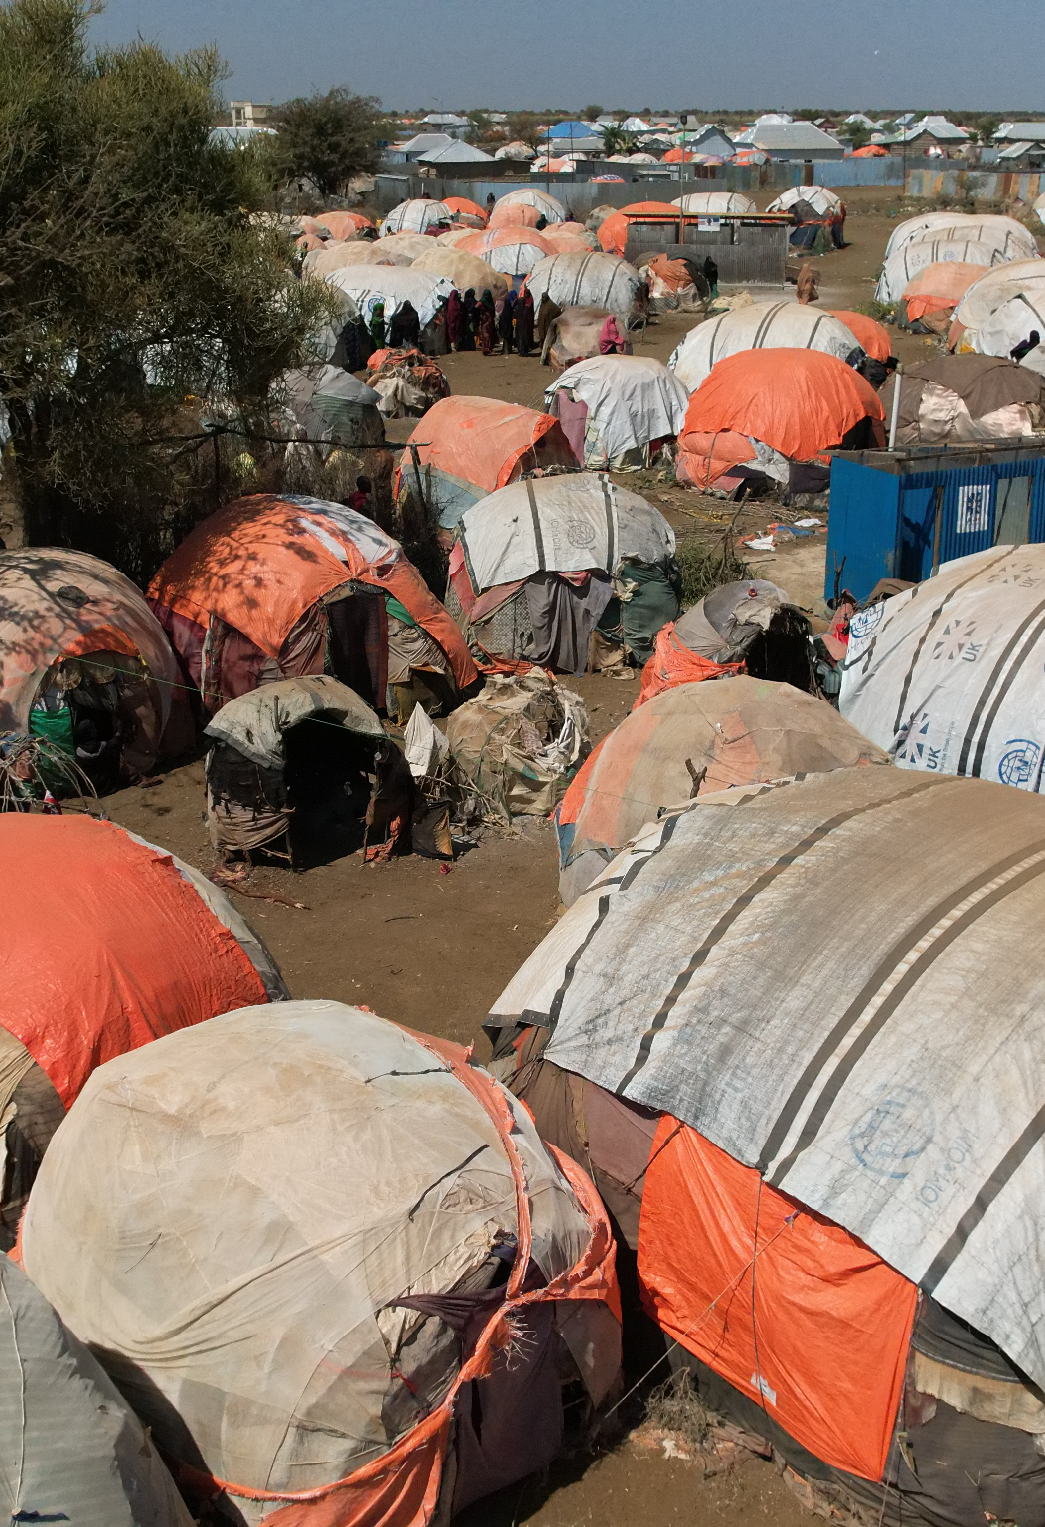
Opportunities for Engagement
Become a Hero Club
Become a Legion of Hero District
Host ShelterBox speakers/presentations
Invite us to speak at major events, DC’s, and PELs
Engage youth through ShelterBox Activities and programs
Nominate a Club Champion/Ambassador
Worldwide service
Sustainability
SHELTERBOX IS A REGISTERED CHARITY INDEPENDENT OF ROTARY INTERNATIONAL AND THE ROTARY FOUNDATION.

Slide 8
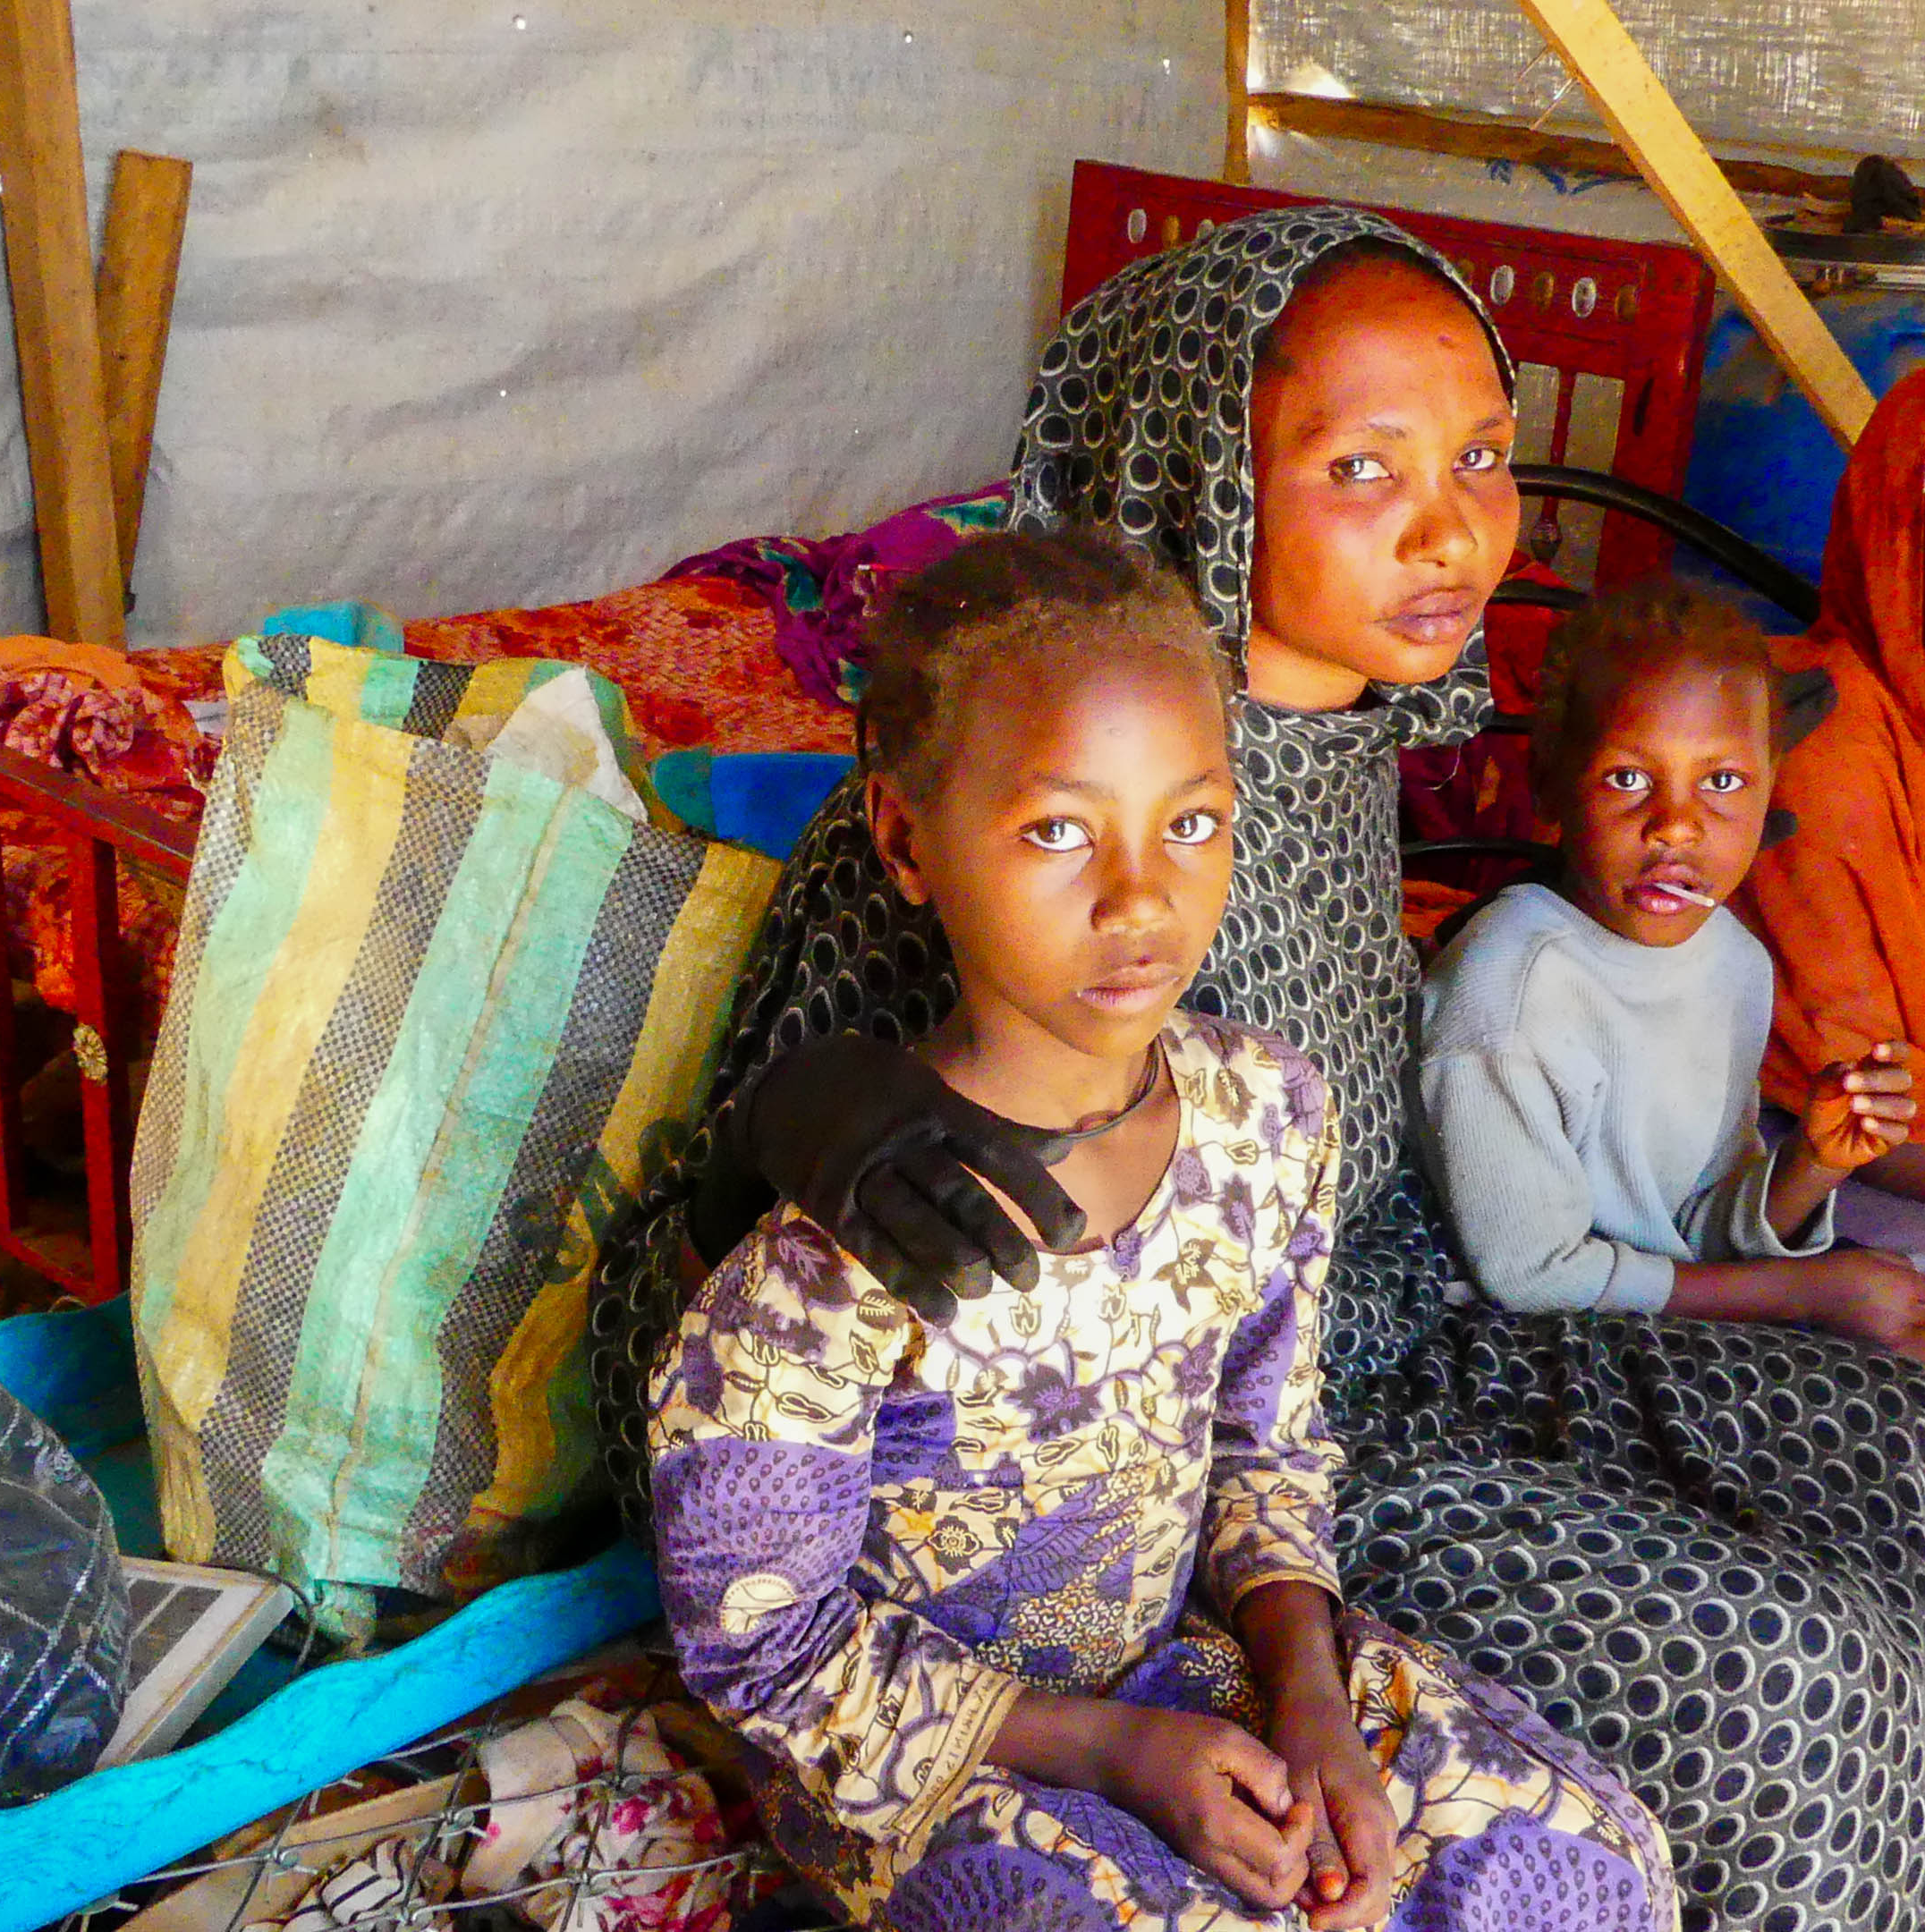
Future of Disaster Relief
With 123 million people displaced world-wide and the increase in natural and man-made disasters, the need for shelter and aid is critical.
Climate change is increasing displacement
More frequent and severe disasters on the rise
Partnership helps communities stay together and rebuild stronger
SHELTERBOX IS A REGISTERED CHARITY INDEPENDENT OF ROTARY INTERNATIONAL AND THE ROTARY FOUNDATION.
Notes:
Rotary’s 7 areas of focus are important to ShelterBox too. At ShelterBox, we are committed to environmental sustainability, balancing our humanitarian work with environmental responsibility. We’re working hard to make our operations greener and reduce our carbon footprint.
Our sustainability priorities for 2024-2026 are:
Minimise the environmental impact of aid items
Develop a better understanding of our freight emissions
Integrate sustainability into our response project plans
Understand more about how aid items can be used after they’ve served their original purpose.
By integrating sustainable practices into everything we do, from head office efficiency and procurement to logistics and community engagement, we can drive systemic change and contribute to a greener, more resilient future for humanitarian aid.
Sustainability is not a one-size-fits-all solution; it is a dynamic approach that should be part of all of our operations. We’re learning and evolving with each step. Small, sustained changes can lead to big impacts.

Slide 9
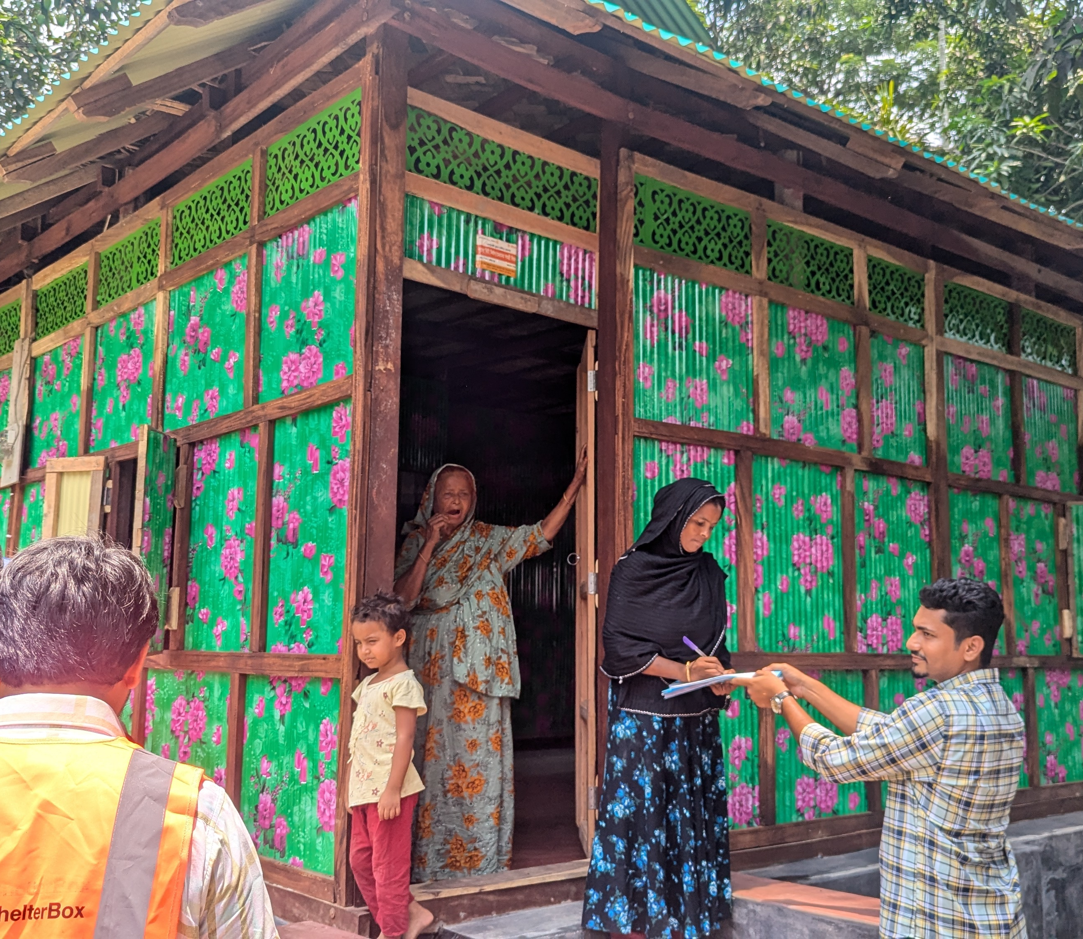
STRONGER TOGETHER
Shelter is more than a roof – it is dignity, safety and hope
Let’s continue to unite for good and ensure no family is left without shelter after disaster
SHELTERBOX IS A REGISTERED CHARITY INDEPENDENT OF ROTARY INTERNATIONAL AND THE ROTARY FOUNDATION.
Notes:
Bangladesh
As tangible as our aid is, it’s important to remember that shelter means more than simply a product – we provide tools for self recovery. A shelter creates a space where families can have privacy from the rest of the world, where they can feel safety and security in being together. We will not stop. We will do whatever it takes to ensure that no family goaes without shelter. With your help we can make sure that no family is forgotten or left behind.

Slide 10
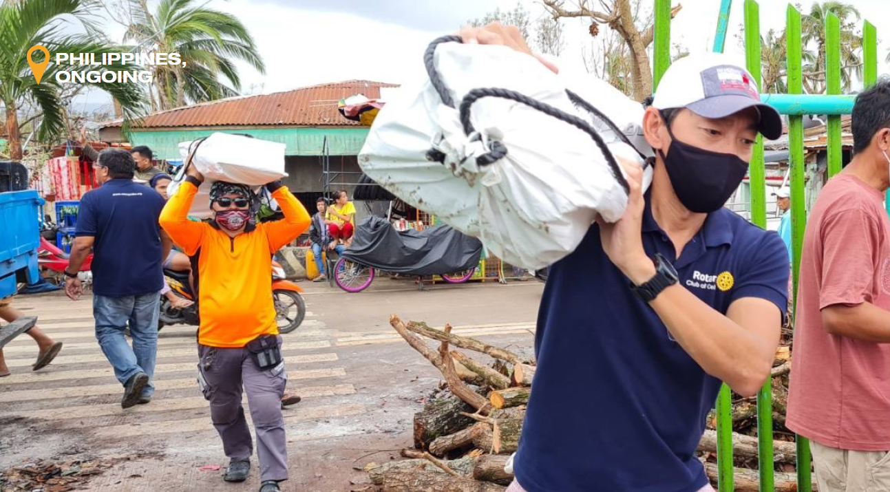
Thank You
Renee Brouse – Rotary Relations Associate – rbrouse@shelterboxusa.org
Notes:
Thank you again for the opportunity to be here with you.
Bernard Vonn Sia from the Rotary Club of Cebu, assisting with distributions of Shelter Kits.
ShelterBox Operations Philippines hold tarpaulins, solar lights, corrugated iron sheeting and other items in a warehouse in Cebu.
Ongoing collaboration with Rotary includes training in needs assessments, damage reporting, local procurement and safeguarding. Meaning that frequent typhoons can be responded to effectively in partnership.

